Slide 1
Graduate Program Dassault Systemes Australia
Computer Science Hackathon
Perth – 8-Sep-18

Slide 2
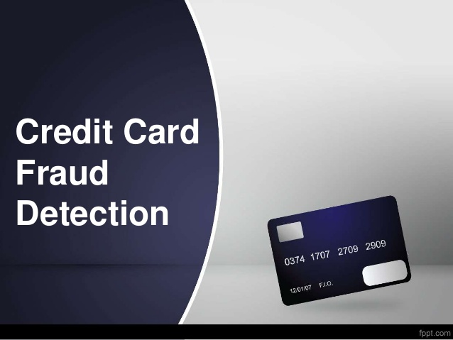
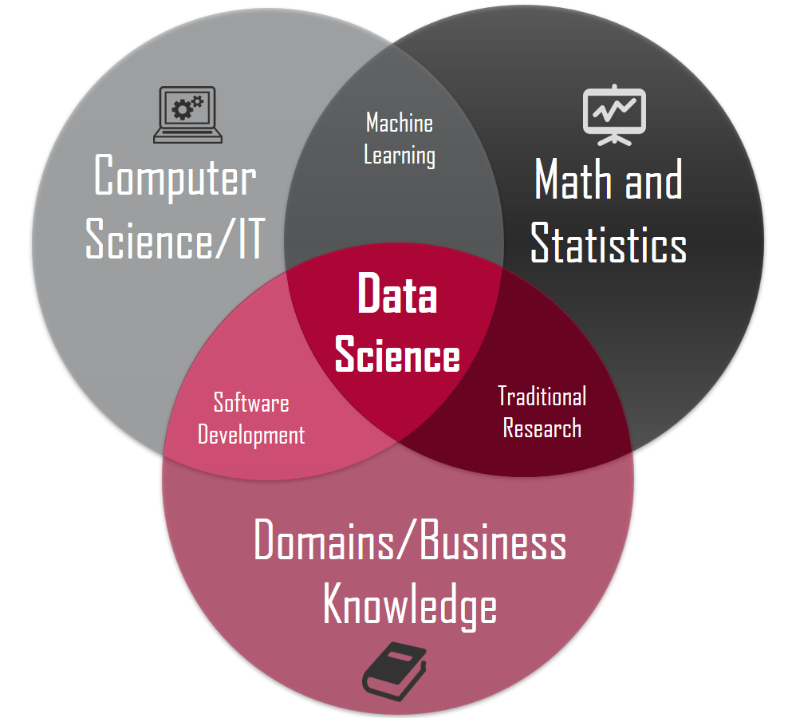
Challenge Statement
Congratulations , You have been hired as a Data Scientist with Citizen’s bank, a multinational bank with operations across the globe.
Citizen’s bank is known for its reliability and safety, has enjoyed a privileged status for nearly 30 years with customers all over the world. Citizen’s bank is known for evolving and transforming itself in all fields to stay ahead of its competitors. Off-late there have been murmurs on safety of credit card transactions with Citizen’s Bank.
Based on an internal study Citizen’s Bank estimates that 0.4% of its customers have been affected by Credit Card frauds. Citizen bank also estimates that it identifies 30% of such frauds in the 1st instance.
The CTO of Citizen’s Bank has convinced the board to invest on a Data Scientist to eliminate any such frauds in the future
So, here is your 1st assignment . You have been provided all credit card transactions for 2 days of this month and all relevant data which is available at this moment with Citizen’s Bank. You are to analyze data trends and identify any credit card frauds in the transactions.

Slide 3
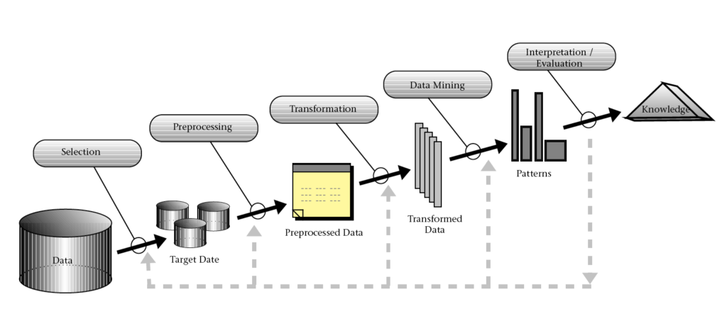
Expected Outputs
A fraud detection algorithm , that shall analyze data provided and flag out fraudulent transactions.
The routine has to be consistent and produce the same results when run on a dataset or a logical subset
An intuitive interactive user interface that is capable of
Displaying all vital details such as transaction date , amount of transaction , status , geographic location etc , on query
Capable of showing steps performed to arrive at the result for a transaction .
Note: Above outputs are to be delivered with technology of your preference and you possess at this moment.
Sample Flow

Slide 4


Evaluation Criteria
4 slide power point presentation containing the below will help us to evaluate you
Understanding of the data
Approach taken to solve the challenge and results
Key Considerations
Any challenges and additional data that may have helped
A live demonstration of your solution

